Slide 1
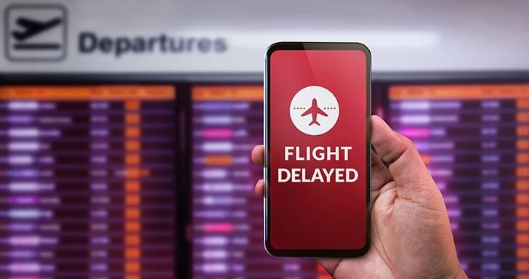
Flight Delay Prediction - An AI powered Solution

Slide 2
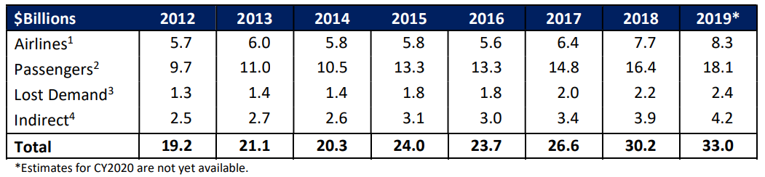
Motivation
Domestic flight delays - $33 billion (2019)
Passengers - Increase in travel time and cost
Airlines - extra costs and affects passenger demand.

Slide 3
About the Data
Data Source : Bureau of Transportation Statistics
Flight data from Sept 21 to Jul 22
Size – 6 million rows and 37 columns
Features like origin and destination airport, taxi out, air time, carrier info, time, departure delay group, etc..

Slide 4
Target label - What are we predicting?
ARR_DEL15
Classifying a data point as 0 if no delay, and 1 if delay by 15 mins or more

Slide 5
Data Challenges
Imbalanced labels – 4:1
Sparse columns/null data
Size

Slide 6
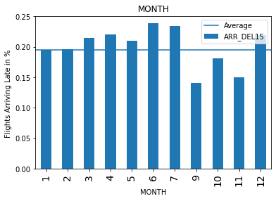
EDA
Flights are mostly delayed in the months of June and July
After that the months having more delays are April and December.

Slide 7
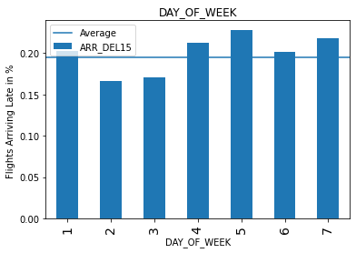
EDA
Thursdays, Fridays, and Sundays are the week-days on which flights mostly delay over 15 mins.

Slide 8
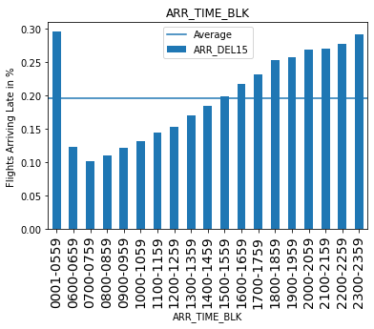
EDA
Flights in day time rarely get delayed
Most delays are in night time

Slide 9
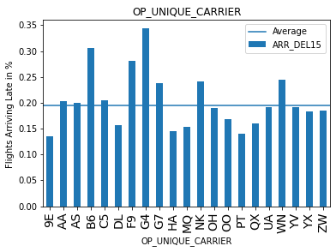
EDA
These are the flight carriers having the most delayed flights than others
G4 - ALLEGIENT AIR LLC
B6 - JET BLUES
F9 - FRONTIER AIRLINES
WN - SOUTHWEST AIRLINES

Slide 10
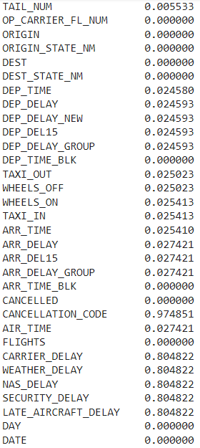
EDA
We drop columns with high sparsity

Slide 11
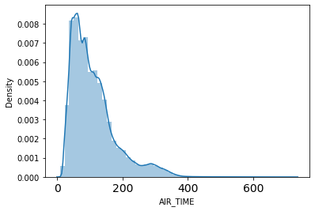
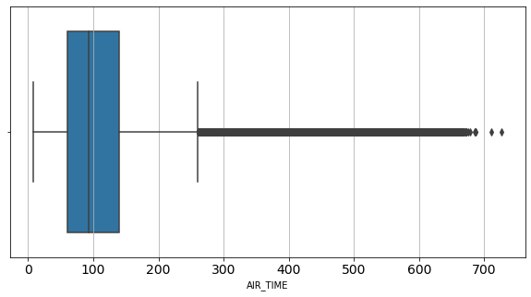
EDA
Distribution of Flight Duration

Slide 12
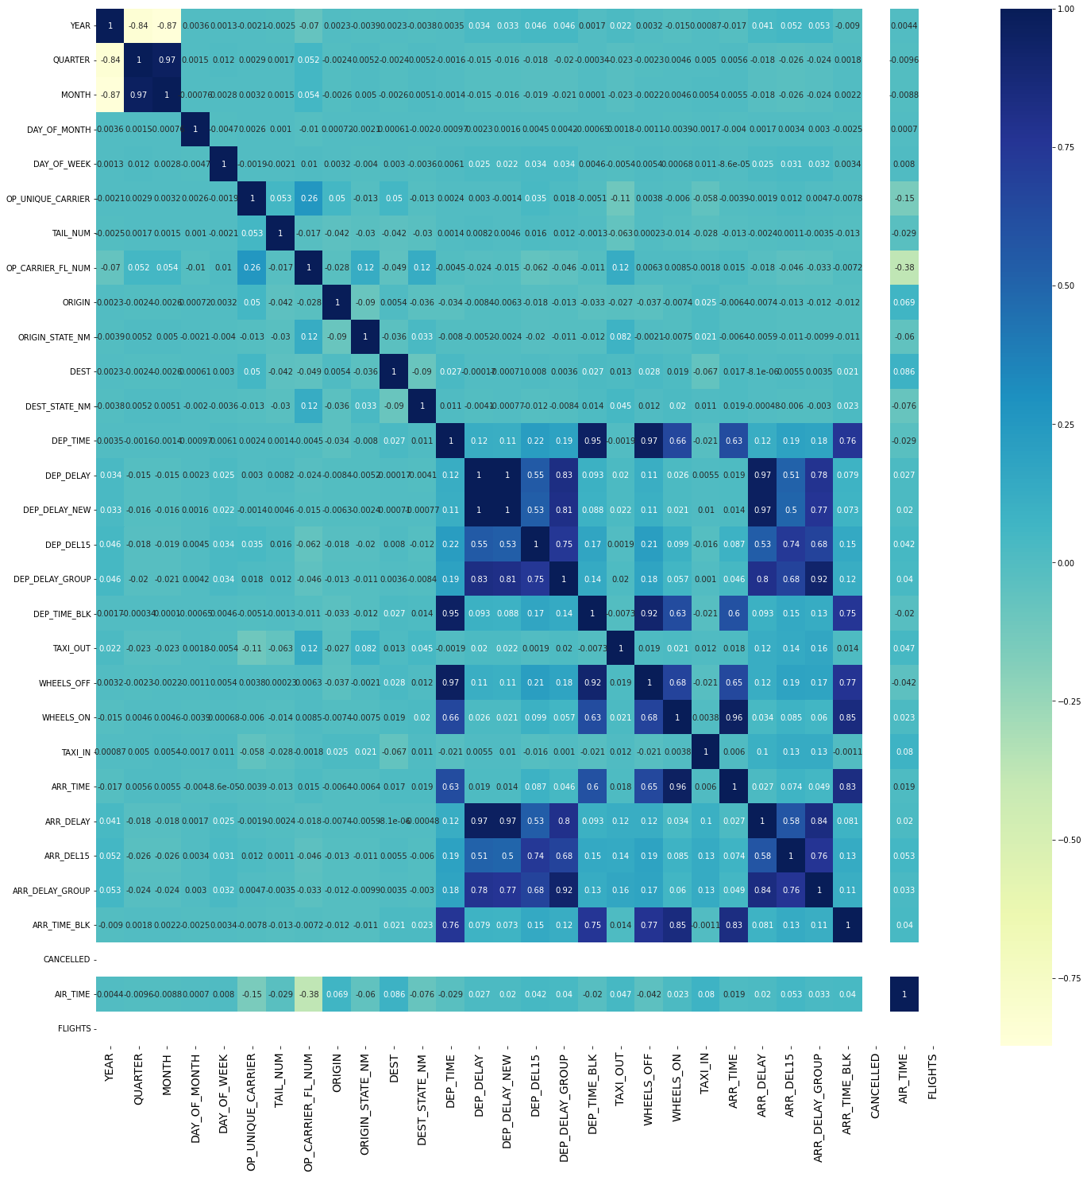
EDA

Slide 13
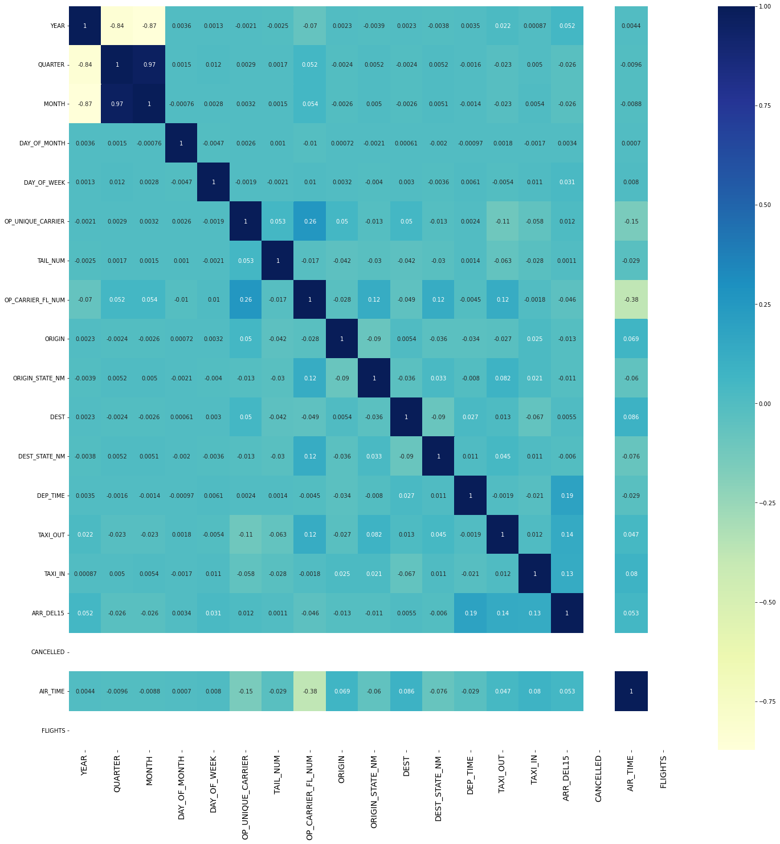
EDA

Slide 14
Models used
Decision Trees
Random Forest
AdaBoost
XGBoost
Neural Networks

Slide 15
Model Training approach
75 -25 Train_Test_Split
K-Fold Cross Validation
Hyper parameter tuning

Slide 16
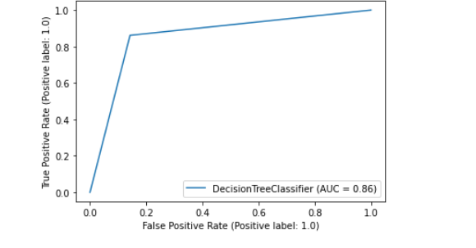
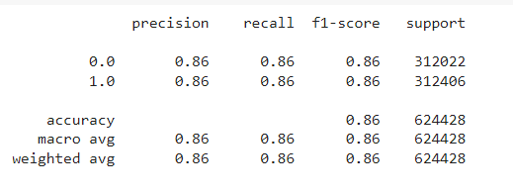
Decision Tree
F1 Score : 86%

Slide 17
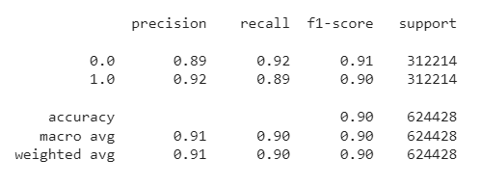
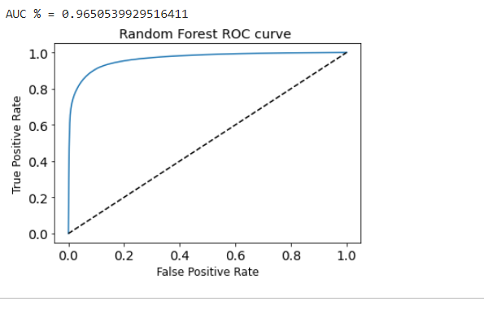
Random Forest
F1 Score : 90%

Slide 18
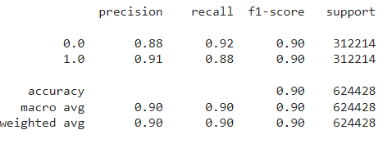
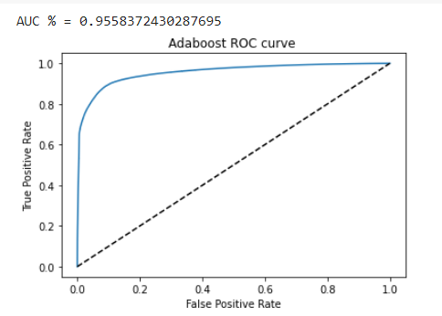
AdaBoost
F1 Score : 90%

Slide 19
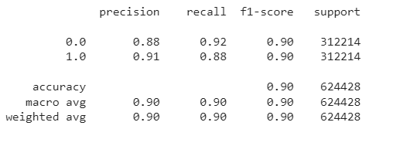
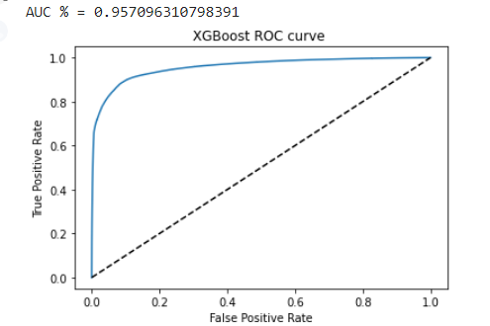
XgBoost
F1 Score : 90%

Slide 20
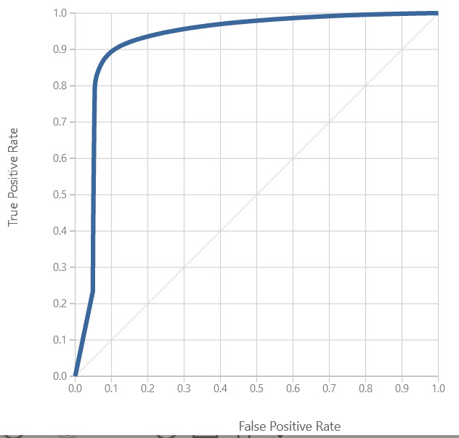
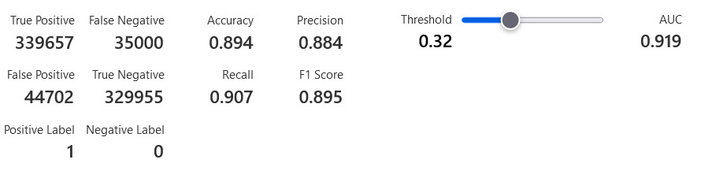
Neural Network
F1 Score : 89.5%

Slide 21
Results
Model | F1 score | AUC
Decision Tree | 86% | 86%
Random Forest | 90% | 96.5%
AdaBoost | 90% | 95.6%
XgBoost | 90% | 95.7%
Neural Network | 89.5% | 91.1%

Slide 22
Further Work
Deploy API in Azure
Increase learning rate of Neural Network
Use data from different time periods
Include data from alternate sources in training

